Slide 1

DATABASE MANAGEMENT SYSTEM
PRESENTED BY:
1.MD.WASHIM AKRAM(368)
2.Md RASHEDUZZAMAN RIAD(402)
3.Md SAIFUR RAHAMAN(212)
4.ARAFAT RAHMAN(165)
5.JAHIDUL HASAN(486)

Slide 2

TOPICS
Introduction to DBMS
DBMS vs File System
Data Abstraction and Level of Abstraction
Instance and Schema
Data Independence
Types of Data Independence
Database Administrator

Slide 3
INTRODUCTION TO DBMS
• A Database Management System (DBMS) is software that manages databases.
• It allows users to create, read, update, and delete data efficiently.
• Ensures data integrity, security, and easy access.
• Examples: MySQL, PostgreSQL, Oracle, MongoDB

Slide 4
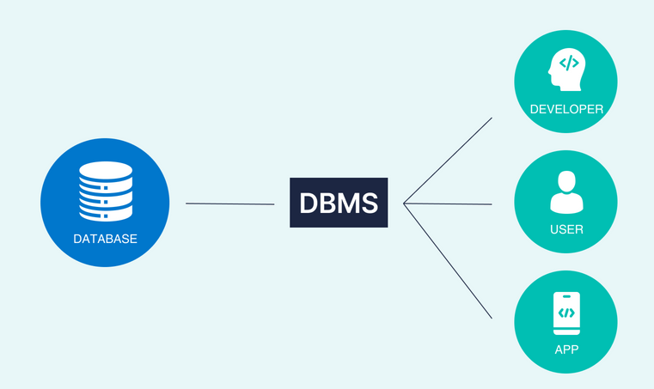

DBMS VS FILE SYSTEM
DBMS:A database-management system (DBMS) is a collection of interrelated data and a set of programs to access those data.
File System: A file processing system is a collection of programs that store and manage files in computer hard-disk.

Slide 5
Advantages of File System
Simple to use and implement. Good for small-scale applications. No complex setup required.
Advantages of DBMS
Provides data consistency and security. Supports multiple users and data relationships. Easy retrieval and efficient data management.

Slide 6
DATA ABSTRACTION AND LEVEL OF ABSTRACTION
Data abstraction is hiding unnecessary details and showing only the relevant data to the user.
Physical level: It describes how a record (e.g., customer) is stored.
Logical level: describes data stored in database, and the relationships among the data.
type customer = record
name : string;
street : string;
city : integer;
end;
View level: application programs hide details of data types. Views can also hide information (e.g., salary) for security purposes.

Slide 7
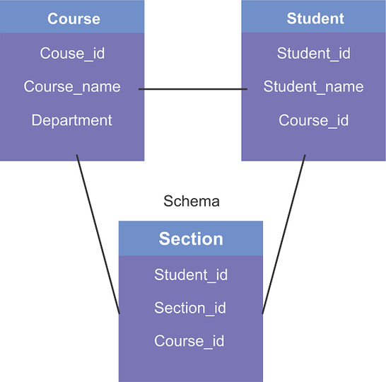
INSTANCE AND SCHEMA
Instance:The data stored in database at a particular moment of time is called instance of database. Database schema defines the variable declarations in tables that belong to a particular database; the value of these variables at a moment of time is called the instance of that database.
Schema:Design of a database is called the schema. Schema is of three types: Physical schema, logical schema and view schema.

Slide 8
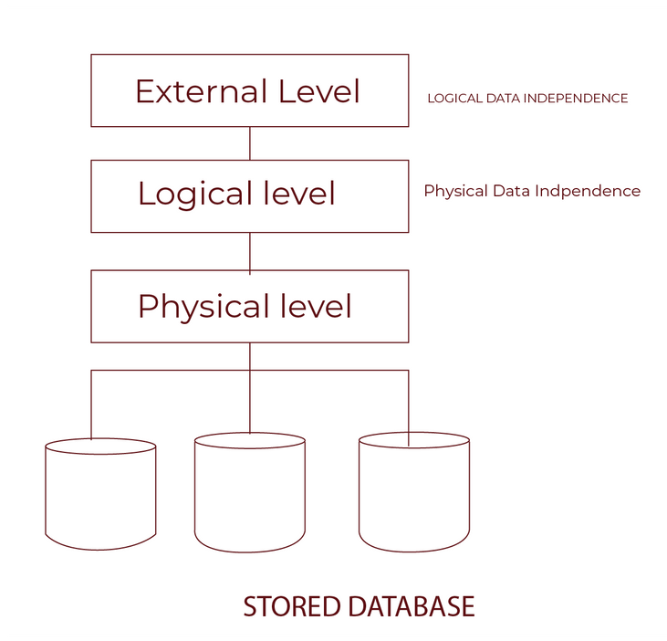
DATA INDEPENDENCE
Data independence is the ability to modify a database schema without affecting the application or user interactions.

Slide 9
TYPES OF DATA INDEPENDENCE
Logical Data Independence: Logical data independence refers characteristic of being able to change the conceptual schema without having to change the external schema.
Physical Data Independence: Physical data independence can be defined as the capacity to change the internal schema without having to change the conceptual schema.

Slide 10
DATABASE ADMINISTRATOR
A Database Administrator (DBA) is responsible for managing and maintaining databases to ensure their security, performance, and availability.
Their key tasks include:
Installation & Configuration.
Performance Monitoring.
Backup & Recovery.
Security Management.
Troubleshooting.

Slide 11
THANK YOU

